Slide 1
California State University, East Bay College of Business and Economics MGMT 6165 Prescriptive Analytics
Nonlinear Optimization Models
Lecture Materials
Dr. Z. Radovilsky
Notes:
1
1

Slide 2
Learning Objectives
Define nonlinear programming (NLP) modeling and optimization
Describe and interpret local maxima and global maximum of NLP problems
Use steps of solving NLP optimization model
Formulate and solve, using NLP models, a range of real applications
Apply Excel Solver to identify optimal solution for these applications using NLP spreadsheet modeling
Apply Excel Solver and SolverTable to analyze optimal solutions
Notes:
2
2

Slide 3
Why Nonlinear Programming (NLP) Models?
A model can become nonlinear for several reasons, including the following:
There are non-constant returns to scale (for example, price or profit per unit), which means that the effect of some input on some output is nonlinear
In pricing models, price is a variable, and quantity of units sold could be a function of price. Thus, maximizing the revenue, as a product of price and demand, make the objective function nonlinear
In financial models, the risk can be measured as the variance (or standard deviation) of the portfolio, which is a nonlinear function of the decision variables. Thus, a financial model that maximizes return and minimizes risk becomes a nonlinear model
The real world often behaves in a nonlinear manner, so when you model a problem with LP, you are typically approximating reality
By allowing nonlinearities in your models, you can often create more realistic models. Unfortunately, this comes at a price - nonlinear optimization models are more difficult to solve

Slide 4
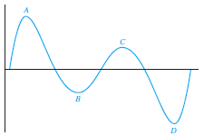
Basic Ideas of NLP Optimization
When you solve an LP problem with Solver, you are guaranteed that the Solver solution is optimal
When you solve an NLP problem, however, Solver sometimes obtains a suboptimal solution
For the figure graphed below, points A and C are called local maxima because the function is larger at A and C than at nearby points
However, only point A maximizes the function; it is called the global maximum
The problem is that Solver can get stuck near point C, concluding that C maximizes the function

Slide 5
How to Use Solver for NLP
Because there is then some doubt whether Solver’s solution is the optimal solution, the best strategy is to
Try several possible starting values for the changing cells
Run Solver from each of these
Take the best solution Solver finds
In general, if you try several starting combinations for the changing cells and Solver obtains the same optimal solution in all cases, you can be fairly confident - but still not absolutely sure - that you have found the optimal solution to the NLP
On the other hand, if you try different starting values for the changing cells and obtain several different solutions, then all you can do is keep the best solution you have found and hope that it is indeed optimal

Slide 6
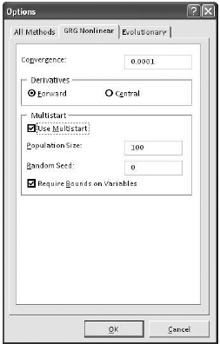
Multistart Option for NLP
Because it is difficult to know where to start, the Multistart feature provides an automatic way of starting from a number of starting solutions
It selects several starting solutions automatically, runs the GRG nonlinear algorithm from each, and reports the best solution it finds
To use the Multistart option, select the GRG Nonlinear method in the Solver dialog box, click on Options and then on the GRG Nonlinear tab. You can then check the Use Multistart box, as shown here

Slide 7
Pricing in Madison Company
The Madison Company manufacturers and retails a certain product. The company wants to determine the price that maximizes its profit from the product. The units cost of producing and marketing the product is $50. Madison will certainly change at least $50 for the product to ensure that it makes some profit.
There is a very competitive market for the product, so that the Madison’s demand falls sharply when it increases its price. For example, when the price for the product was $70, the demand was 400 units, but when the price went up to $80, the demand went down to 300 units. In this case, consider demand as a linear demand function: D = a + bP, where D = demand, P = price, a and b are intercept and slope, respectively. Demand may be also considered as a constant elasticity demand function: D = aP^{b} .
Use one of these demand functions in a nonlinear optimization model to identify the price that maximizes the company’s profit.

Slide 8
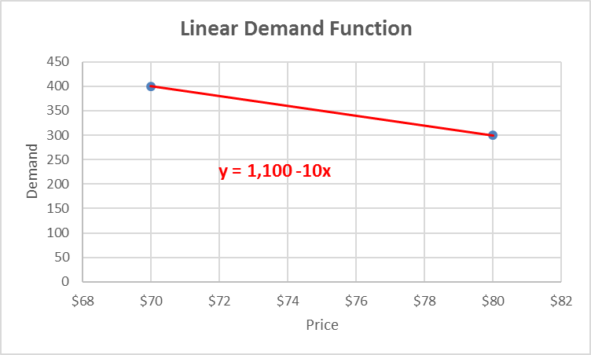
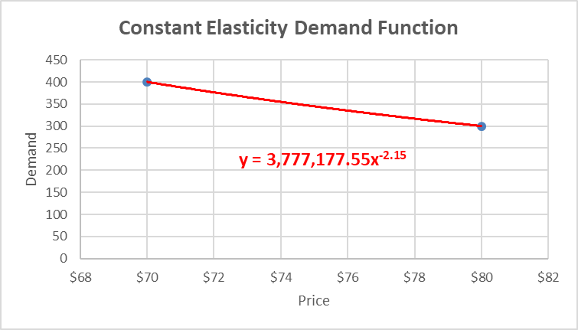
Linear and Constant Elasticity Demand Functions

Slide 9
Optimal Solution for Linear Demand Function

Slide 10
Optimal Solution for Constant Elasticity Demand Function

Slide 11
Pricing Suits at Sullivan’s
Sullivan’s is a retailer of upscale men’s clothing. Suits cost Sullivan’s $320 per unit. This history of Sullivan’s prices and associated suit demands is summarized in the table on the right.
Each purchase of a suit leads to an average of 2.0 shirts and 1.5 ties being sold with this suit. Each shirt contributes $25 to the profit, and each tie contributes $15 to the profit.
The dollar figures are likely supplied by a cost accountant. The demand function can be estimated using the historical data of the relationships between demand and price (like in case of the previous example). The average numbers of shirts and ties sold with suit purchases are also available from historical data.
Use an NLP model to determine a profit-maximizing price for suits, taking into account the purchases of shirts and ties that typically accompany purchases of suits.

Slide 12
Modeling Demand Function for Sullivan’s Suits

Slide 13
Optimal Solution for Sullivan’s Suit Price

Slide 14
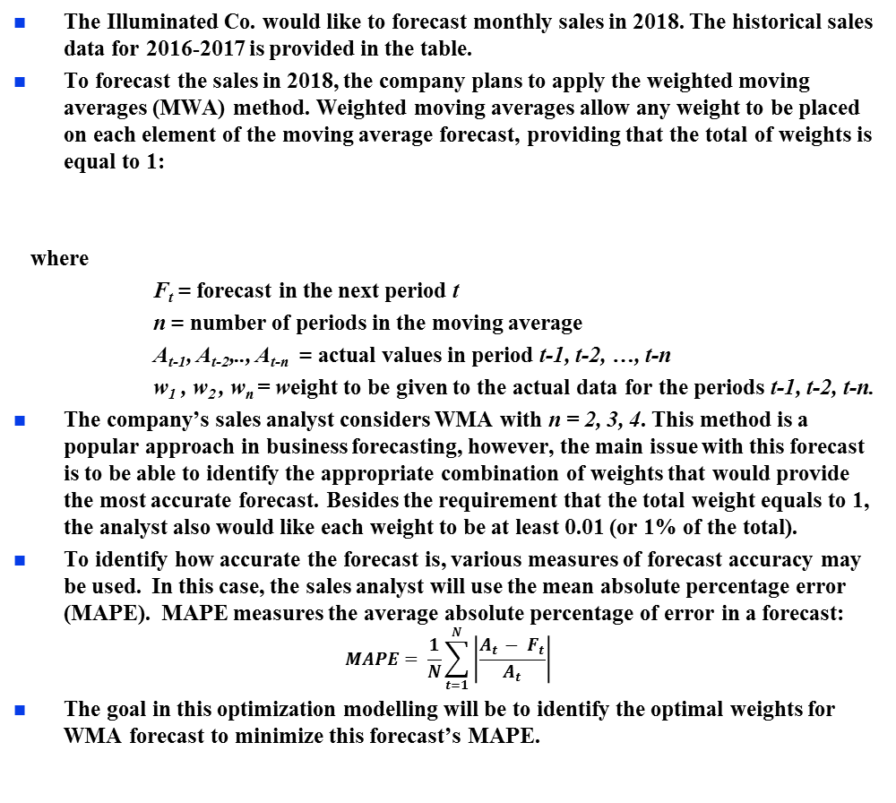
Forecasting: Optimizing Weights in Weighted Moving Averages
The Illuminated Co. would like to forecast monthly sales in 2018. The historical sales data for 2016-2017 is provided in the table.
To forecast the sales in 2018, the company plans to apply the weighted moving averages (MWA) method. Weighted moving averages allow any weight to be placed on each element of the moving average forecast, providing that the total of weights is equal to 1:
where
F_{t} = forecast in the next period t
n = number of periods in the moving average
A_{t-1}, A_{t-2},.., A_{t-n} = actual values in period t-1, t-2, …, t-n
w₁ , w₂ , w_{n} = weight to be given to the actual data for the periods t-1, t-2, t-n.
The company’s sales analyst considers WMA with n = 2, 3, 4. This method is a popular approach in business forecasting, however, the main issue with this forecast is to be able to identify the appropriate combination of weights that would provide the most accurate forecast. Besides the requirement that the total weight equals to 1, the analyst also would like each weight to be at least 0.01 (or 1% of the total).
To identify how accurate the forecast is, various measures of forecast accuracy may be used. In this case, the sales analyst will use the mean absolute percentage error (MAPE). MAPE measures the average absolute percentage of error in a forecast:
$$MAPE= \frac{1}{N}\sum_{t=1}^{N}{\left|\frac{A_{t }− F_{t}}{A_{t}}\right|}$$
The goal in this optimization modelling will be to identify the optimal weights for WMA forecast to minimize this forecast’s MAPE.

Slide 15
Initial WMA Model

Slide 16
Optimal WMA Models

Slide 17
Pickens Memorial Hospital
The weekly income at Pickens memorial Hospital depends on the number of patients admitted in the three separate categories: medical, surgical, and pediatric. The hospital can admit a total of 100 medical patients, 80 surgical patients, and 60 pediatric patients each week. However, because Pickens Memorial serves a large community, patient demand in each category by itself exceeds the total patient capacity.
Due to fixed overhead, the profit per patient in each category actually increases as the number of patients increases. Further, some patients who are initially classified as medical patients then get reclassified as surgical patients. As a result, the profit per surgical patient also depends on the number of medical patients admitted. The accountants at Pickens Memorial have analyzed the situation, and have identified the following information:
income contribution per medical patient: = $120 + $8M
Income contribution per surgical patient: = $200 + $10S + $3M
Income contribution per pediatric patient: = $95 + $9P
Where M = number of medical patients admitted; S = number of surgical patients admitted; and P = number of pediatric patients admitted
Perkins Memorial identified three main constraints for this model: x-ray capacity: scanning capacity (x-rays, MRI, and CT scans), surgical rooms capacity, and lab capacity. Table below shows the relevant weekly data for these three constraints for each category of patient. The table also shows the weekly availabilities of each of these resources: total number of scannings and surgical procedure is 420 and 90, respectively, and total hours of testing is 1150 hours.
The hospital’s chief laboratory supervisor has noted that the required time per lab test increases as the total number of patients increases. Based on historical data, the supervisor estimates this relationship to be as follows:
Time required per lab test (in hours) = 2 + 0.001(M + S + P)
Develop and solve an NLP model that identifies the optimal number of patients to be admitted to the Pickens Memorial Hospital that maximizes the total weekly income in the hospital.

Slide 18
Formulation of NLP Model for Pickens Memorial Hospital
Decision Variables
M = number of medical patients admitted
S = number of surgical patients admitted
P = number of pediatric patients admitted
Objective – maximize gross income
Max ($120 + $8M)M + ($200 + $10S + $3M)S + ($95 + $9P)P
Constraints
Capacity for medical patients: M ≤ 100
Capacity for surgical patients: S ≤ 80
Capacity for pediatric patients: P ≤ 60
Scanning capacity: M + 3S + 2P ≤ 420
Surgical capacity: 1.15S ≤ 90
Lab capacity, hours: (2M + 2.5S + 2P)(2 + 0.001(M + S + P)) ≤ 1150
Nonnegativity and integer M, S, P ≥ 0 and integer

Slide 19
Spreadsheet Model for Pickens Memorial

Slide 20
Solution Results for Pickens Memorial Hospital

